Slide 1
Final Exam
EFB 306 – Wildlife Field Techniques
Cranberry Lake Biological Station
Summer 2025

Slide 2
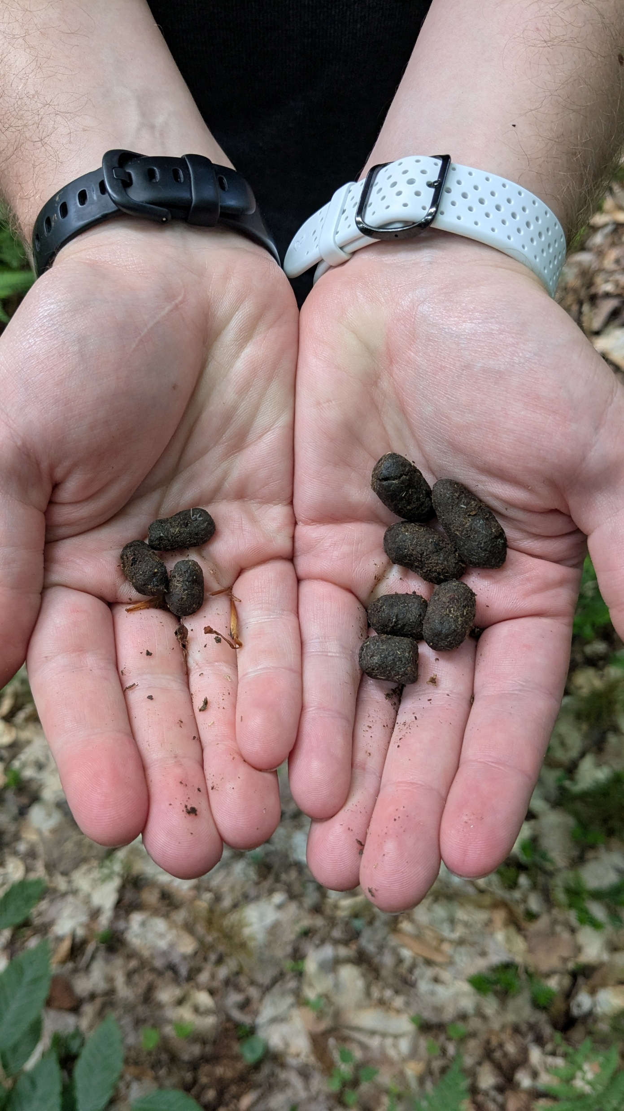
Q1: What two species do these scats belong to?
A
B
Notes:
White-tailed deer; moose

Slide 3
Q2: Name 2 characteristics important for choosing
the location of a mist net for birds.
Notes:
Low sunlight, bird sounds/spoor, low-lying vegetation, low wind, clear alleyway/flyway

Slide 4
Q3: Name 3 species of bats (Order: Chiroptera)
that you might observe in New York.
Notes:
Big brown, eastern red, hoary, silver-haired, eastern small-footed, little brown, northern long-eared, Indiana, tri-colored

Slide 5
Q4: Name 3 types of study sampling designs.
Notes:
Simple random, stratified random, grid/systematic, adaptive cluster, judgement, random block, ranked set

Slide 6
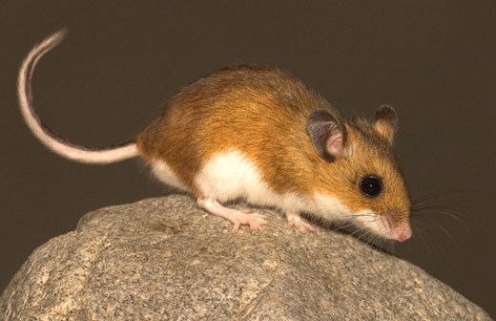
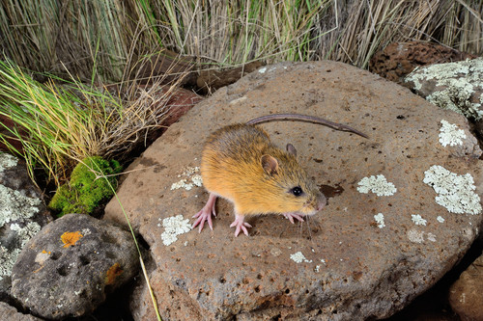
Q5: What two species of
forest-dwelling rodents are pictured below?
A
B
Notes:
Deer mouse; meadow jumping mouse

Slide 7
Q6: Why should camera traps always face north?
Notes:
To avoid sun glare

Slide 8
Q7: What are the 4 types of ethological sampling?
Notes:
Continuous focal, continuous scan, instantaneous focal, instantaneous scan

Slide 9
Q8: Name 3 types of spoor.
Notes:
Scat, tracks, fur/feathers, herbivory/food scraps, dens/nests, smells, sounds, the animals themselves

Slide 10
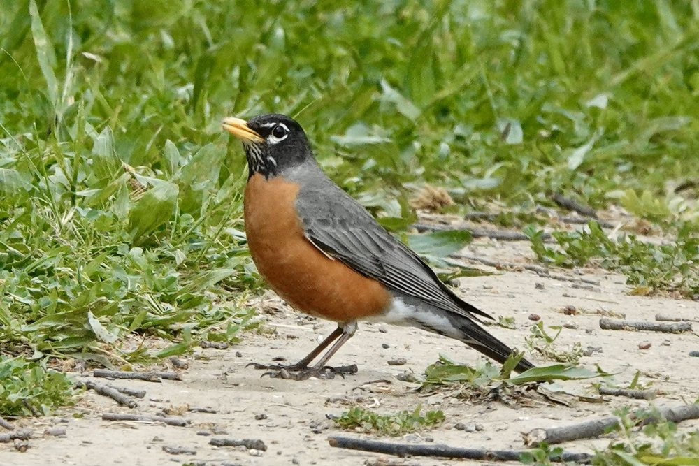
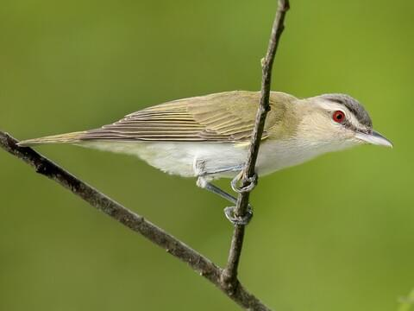
Q9: What two species of birds are pictured below?
A
B
Notes:
American robin; red-eyed vireo

Slide 11
Q10: What does IACUC stand for?
Notes:
Institutional animal care and use committee

Slide 12
Q11: Name 2 characteristics important for choosing
the location of a scent lure
when targeting mesocarnivores.
Notes:
Sufficiently open space for the camera and lure; mesic/mixed habitats; boulders/deadfall; minimal ground-level foliage; local topography/hydrology; (animal spoor)

Slide 13
Q12: What does “gain” control when doing radio telemetry?
Notes:
The size of your search cone

Slide 14
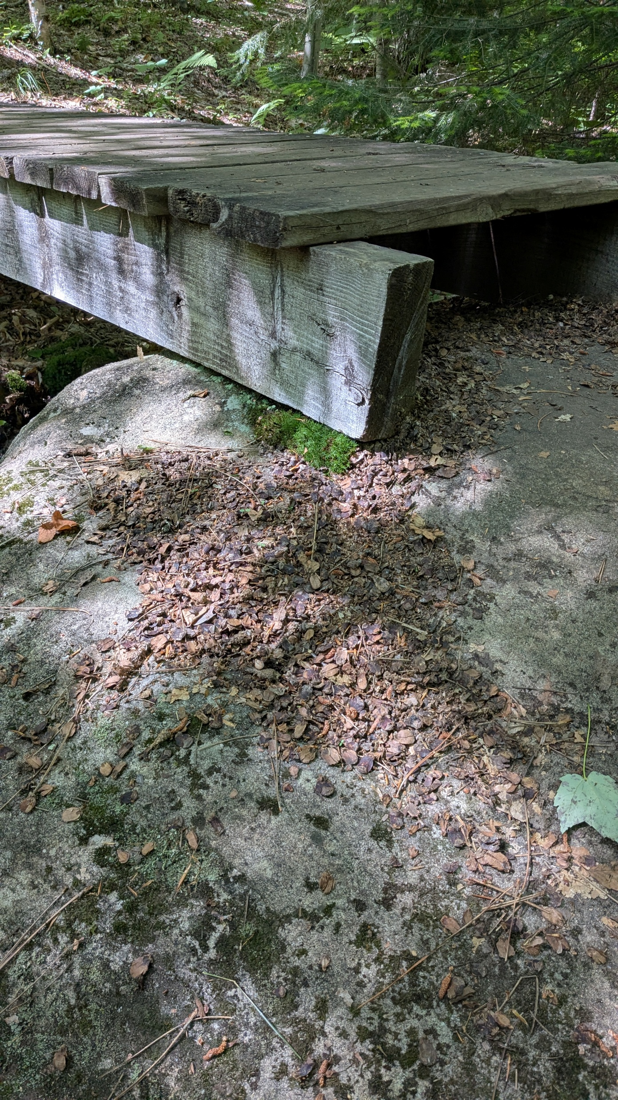
Q13: What species leaves behind
piles of pinecone flakes
at local high points?
Notes:
Red squirrel (or porcupine)

Slide 15
Q14: What sex of bats most likely live
in the CLBS bat boxes?
How can you tell?
Notes:
Female, frequent return trips

Slide 16
Q15: Define bycatch.
Notes:
The capture of non-target species

Slide 17
Q16: Name 1 type of radio telemetry antenna.
Notes:
Yagi, H, Omni

Slide 18
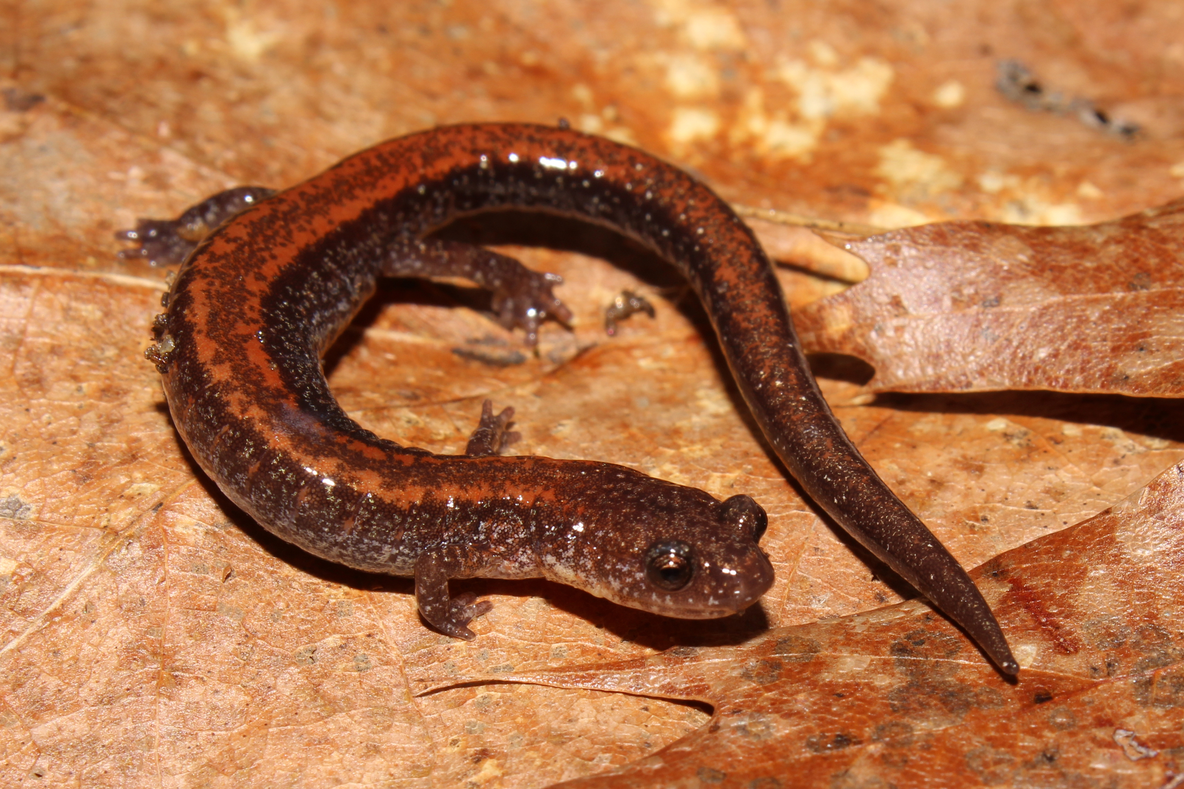
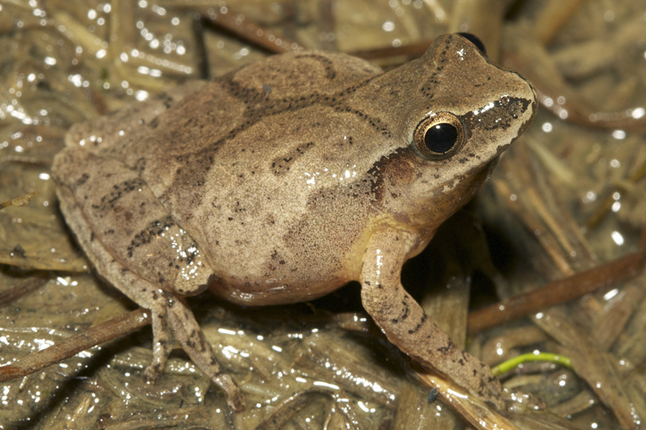
Q17: What two species of
amphibians are pictured below?
A
B
Notes:
Red-backed salamander; spring peeper

Slide 19
Q18: Name a metric (or score) for biodiversity at a site (besides species richness).
Notes:
Simpson’s Index, Shannon-Weiner Index, alpha/beta/gamma diversity

Slide 20
Q19: What does ARU stand for?
Notes:
Autonomous recording unit

Slide 21
Q20: What are the 4 kinds of heterodont mammal teeth?
Notes:
Incisors, canines, pre-molars, and molars

Slide 22
Q21: Name 2 kinds of small mammal traps.
Notes:
Pitfall, Sherman, tomahawk, havahart, or box in place of S/T/H

Slide 23
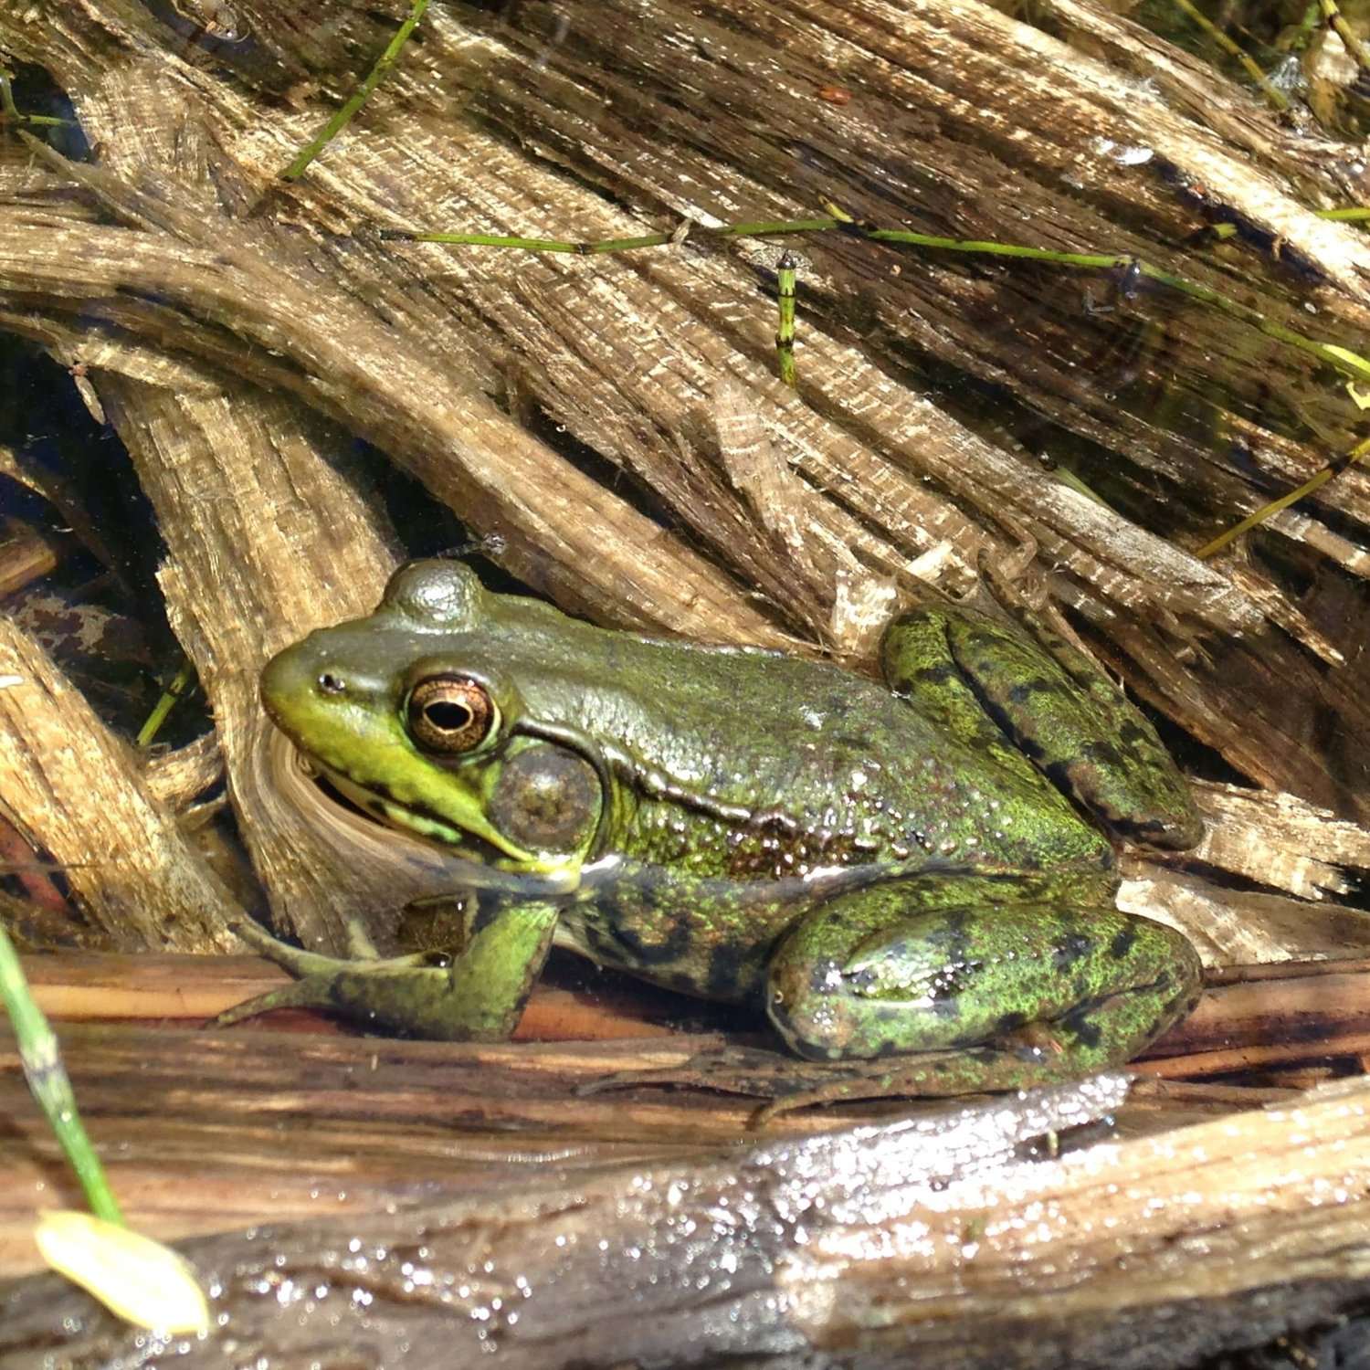
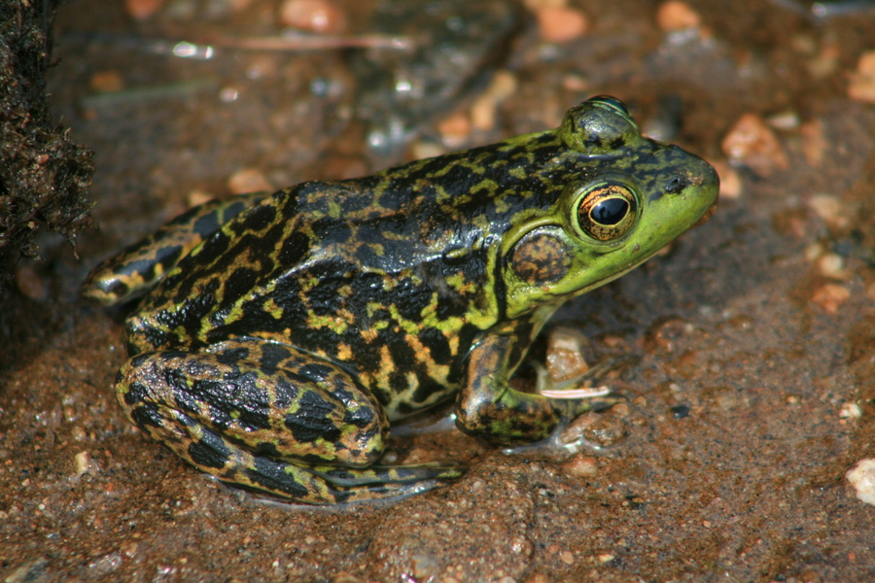
Q22: What two species of
amphibians are pictured below?
A
B
Notes:
Green frog, mink frog

Slide 24
Q23: There are four sexes of white-throated sparrows,
what are they?
Notes:
white-striped males/females and tan-striped males/females

Slide 25
Q24: Name 3 vegetation metrics
we might record to assess habitat
Notes:
% canopy cover, % understory density, species composition, species height, browsing pressure

Slide 26
Q25: What is an ethogram?
Notes:
A table defining animal behaviors

Slide 27
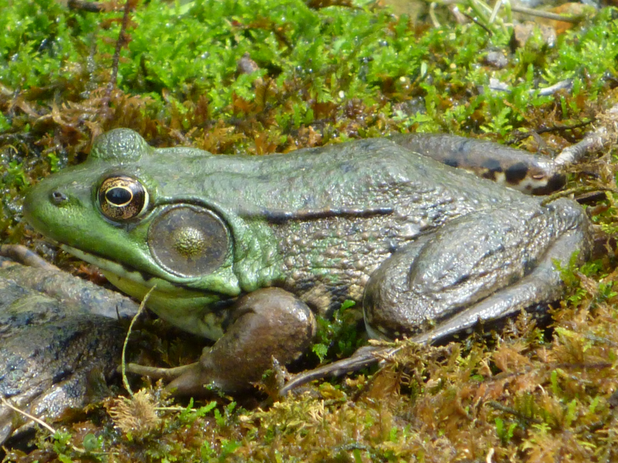
Q26: Which of these two frogs is the male?
A or B?
A
B
Notes:
B

Slide 28
Q27: In how many directions does an ARU record sound?
Notes:
360 degrees

Slide 29
Q28: What term describes animals that
are primarily active at dawn and dusk?
Notes:
Crepuscular

Slide 30
Q29: Name 3 of the 7 pillars of
the North American Model of Wildlife Conservation.
Notes:
Wildlife is a public trust, no sale of wildlife, government sets harvest regulations, equal opportunity to hunt, killed only for a legit purpose, international resource, science guides management

Slide 31
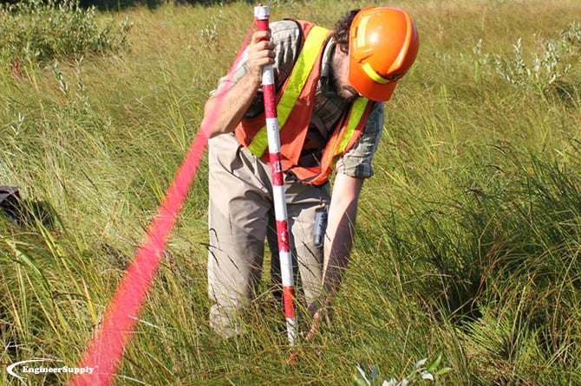
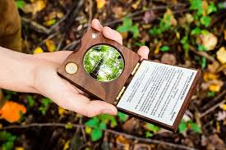
Q30: What are these two tools used to assess?
A
B
Notes:
Ground-cover density, canopy cover

Slide 32
Bonus:
Name 4 techniques used
to survey fish communities.
Notes:
Gill nets, electrofishing, throw/cast netting, rod and reel, fyke nets, seine nets; trawl/long-line audits

